Slide 1
FOOD AND DRUG ADMINISTRATION
BY IVISION
DATA ANALYST : PAVNEET KAUR

Slide 2
INTRODUCTION
The U.S. Food and Drug Administration (FDA) is a federal agency responsible for safeguarding public health in the United States. It oversees various areas, including food safety, pharmaceuticals, medical devices, cosmetics, tobacco, and veterinary products. The FDA evaluates the safety and efficacy of drugs, biological products, and medical devices, conducts inspections, and enforces regulations. It also regulates food production and distribution, conducts research, provides public health education, and monitors and responds to emerging health risks. The FDA's mission is to protect and promote public health by ensuring the safety and effectiveness of a wide range of products and substances.
Ivision is to perform Data Analysis on the FDA dataset using SQL and PowerBI.

Slide 3
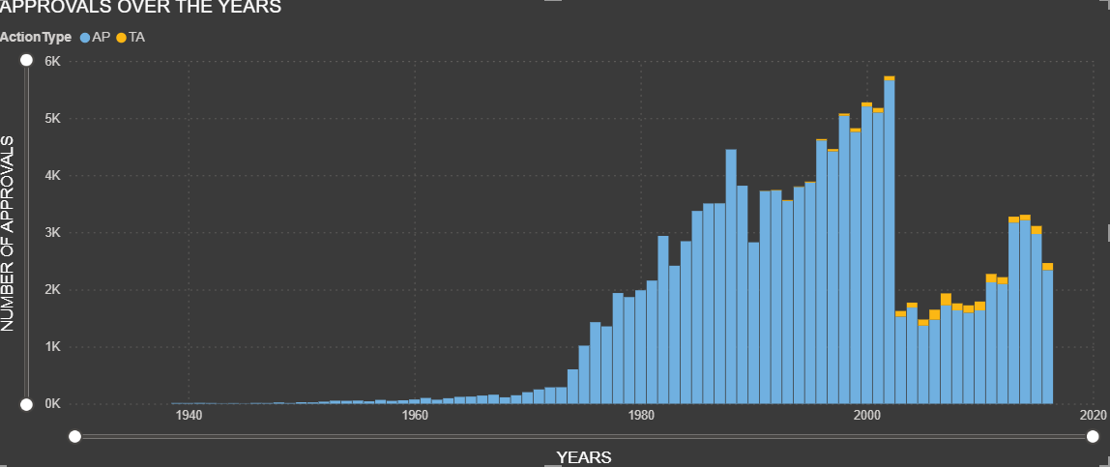
YEARLY APPROVAL TREND
ACTION TYPE | MAXIMUN
APPROVAL(AP) | 2002
THERAPEUTIC AREA (TA) | 2003

Slide 4
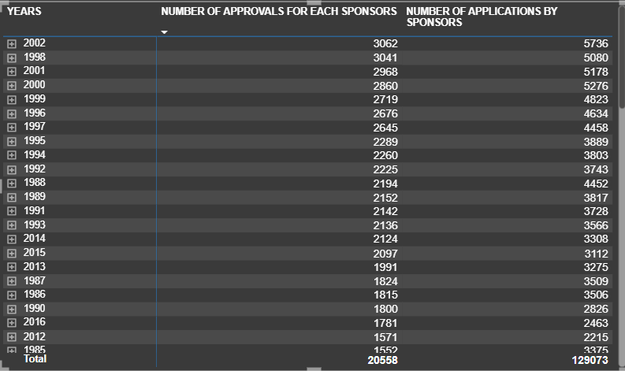
SPONSORS OVER THE YEARS

Slide 5
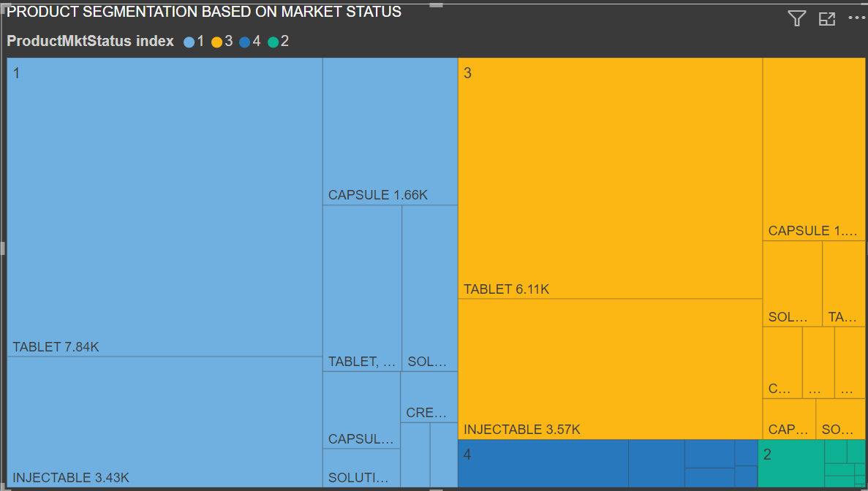
PRODUCT MARKET CATEGORY

Slide 6
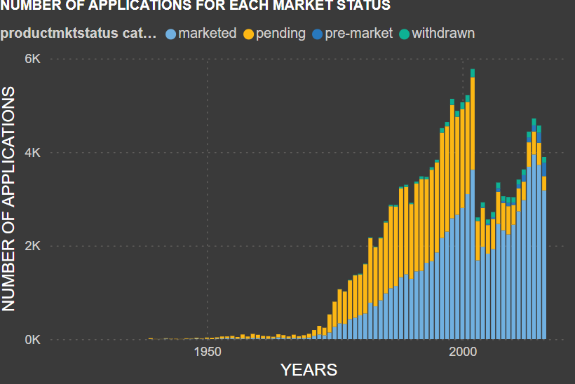
APPLICATIONS FOR EACH MARKET STATUS

Slide 7
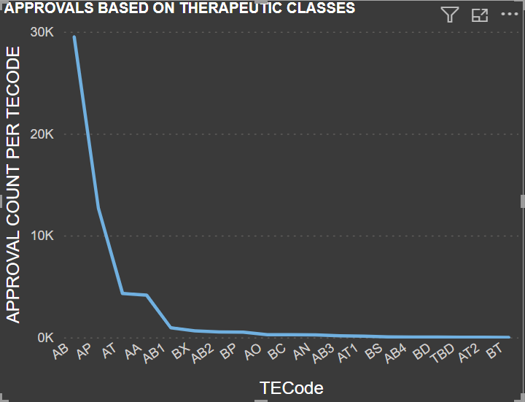
APPROVALS FOR THERAPEUTIC CLASSES

Slide 8
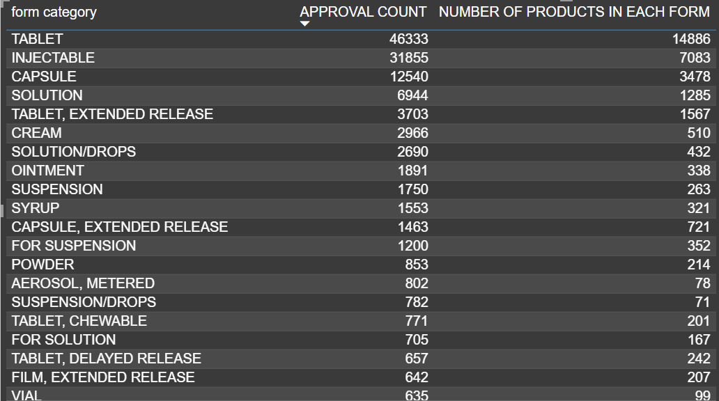
APPROVAL PER FORM CATEGORY

Slide 9
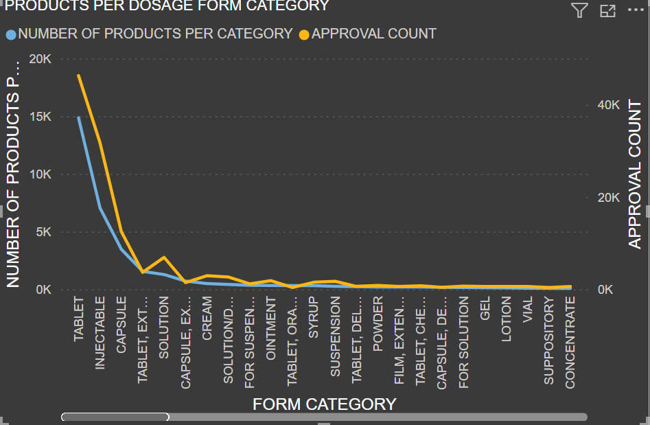
GROUPING OF PRODUCTS BY DOSAGE FORM

